Slide 2

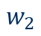
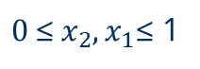

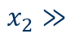
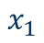
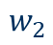
Data Pre-Adjustments Normalization
Data is normalized, before given to the network.
$$w_{2}$$
${\text{0 }\text{≤} x}_{2},x_{1}\text{≤}$ 1
$$w_{2}$$
$$x_{2}≫$$
$$x_{1}$$
$$w_{1}$$
$$w_{1}$$
For skewed classes, learning will be slower!
This is why you need to scale the input values to have unit variance and zero mean:

Slide 3
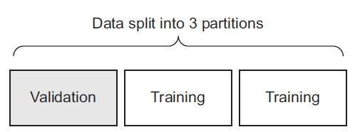
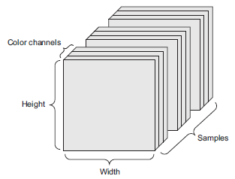
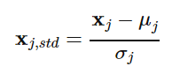
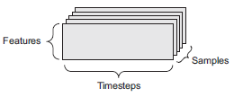
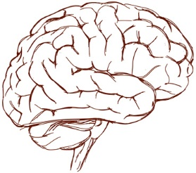


Data Pre-Adjustments Train Test Validation splitting
Image Data
Normalization to counteract skewed data/classes:
Normalization
Training
Validation
Test
Train Network Weights
Optimize Network Parameters
Verify Results on unseen data
Time Series Data

Slide 4
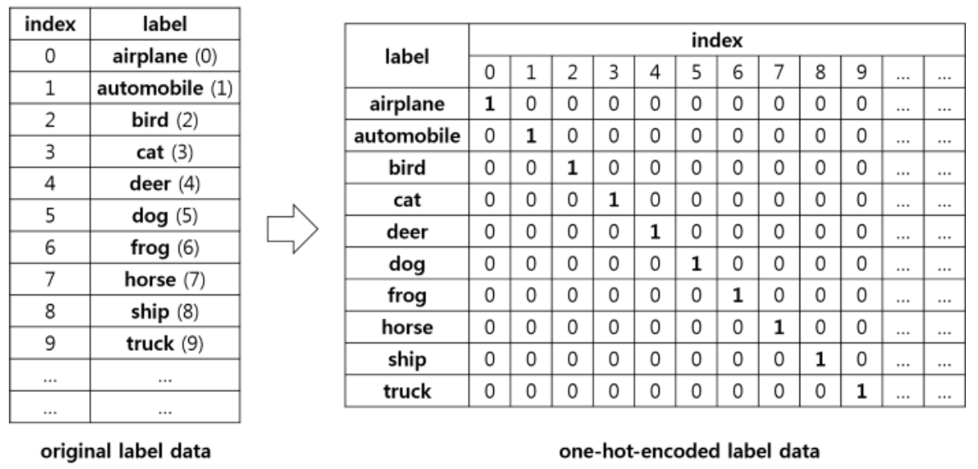
Label Pre-Adjustments One-Hot Encoding

Slide 5
The Keras Software & Hardware Stack
Keras
Keras is a „top level“ python class inheriting from other important liberies written in python.
It inhertis neural networks functions from packages like tensorflow (Google) or torch (Facebook).
Tensorflow
/Torch
Other important Libs e.g. Numpy
Python
CUDA/CuDnn
Blas/Eigen
GPU
CPU

Slide 6
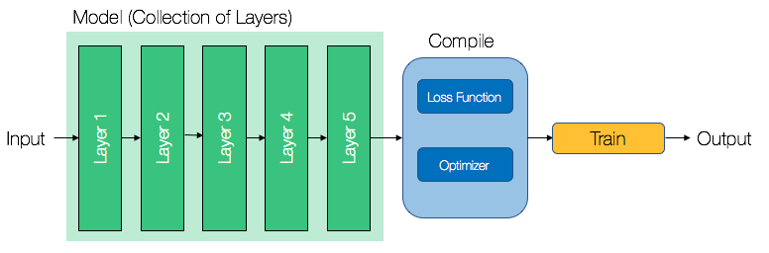
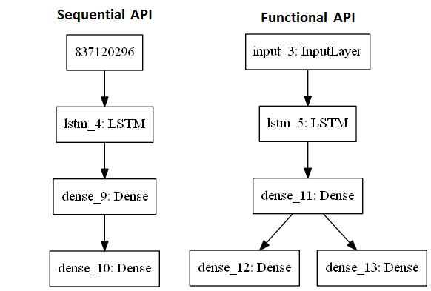
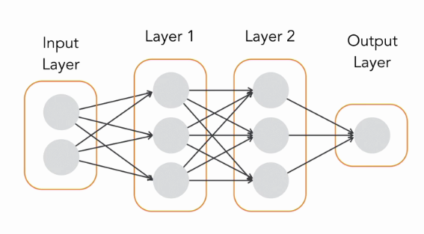
Keras Sequential API
Lets classify cloths (10 classes)!
Data
Dense
Dense
Data
(Input Layer)
Dense or Softmax Layer
Dense /Softmax
Dense Layer
Dense Layer

Slide 7
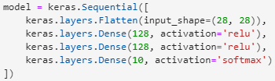
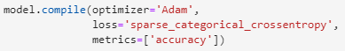
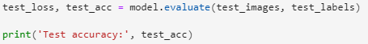
Keras Sequential API
Load Data:
Lets classify cloths (10 classes)!
Define Model:
Data
Define Optimizer:
Dense
Train the Model
Dense
Test the Model
Dense /Softmax
Use model to make predictions:

Slide 8
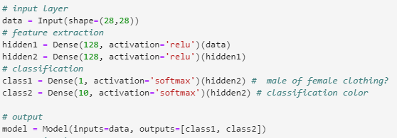
Keras Functional API
Lets classify cloth and if is‘s female or male clothing with the same neural network! We gonna need branching for this which is part of the more flexibel Functional API.
Data
Define Model:
Data
Dense
Dense
Dense
Dense
Everything else stays the same!
Dense /Softmax
Dense /Softmax
Dense /Softmax

Slide 9
4. Exercise Let‘s train our first classifier with Keras!

